Slide 1
Stock Performance Analysis
Group Members
Poonam Amol Mathane
Sumit Kumar Das
Madathala Satya Raj
Gunisetty Harshitha
Arpita Hiremath
Aditya Bipin Raval
Richa Mishra

Slide 2




Project analysis slide 2
Stock Performance Analysis
CONCLUSION
INTRODUCTION
Agenda
CHALLENGES
DATA TRANSFORMATION
DASHBOARD’s
KPI’s

Slide 3
Project analysis slide 3
Stock Performance Analysis
INTRODUCTION
This presentation introduces the world of stock market performance, shedding light on its importance and key elements.
It covers metrics like stock indices, market capitalization, and volatility, while explaining the concepts of bull and bear markets.
The influence of economic indicators, corporate earnings, and global events on market behavior is explored.
The significance of diversified sectors and historical performance analysis is highlighted.
The presentation also touches on investor sentiment, acknowledging challenges and risks such as market corrections and behavioral biases.
Lastly, it discusses adapting to emerging trends, strategic investment approaches, and the enduring value of a long-term perspective for investors.

Slide 4
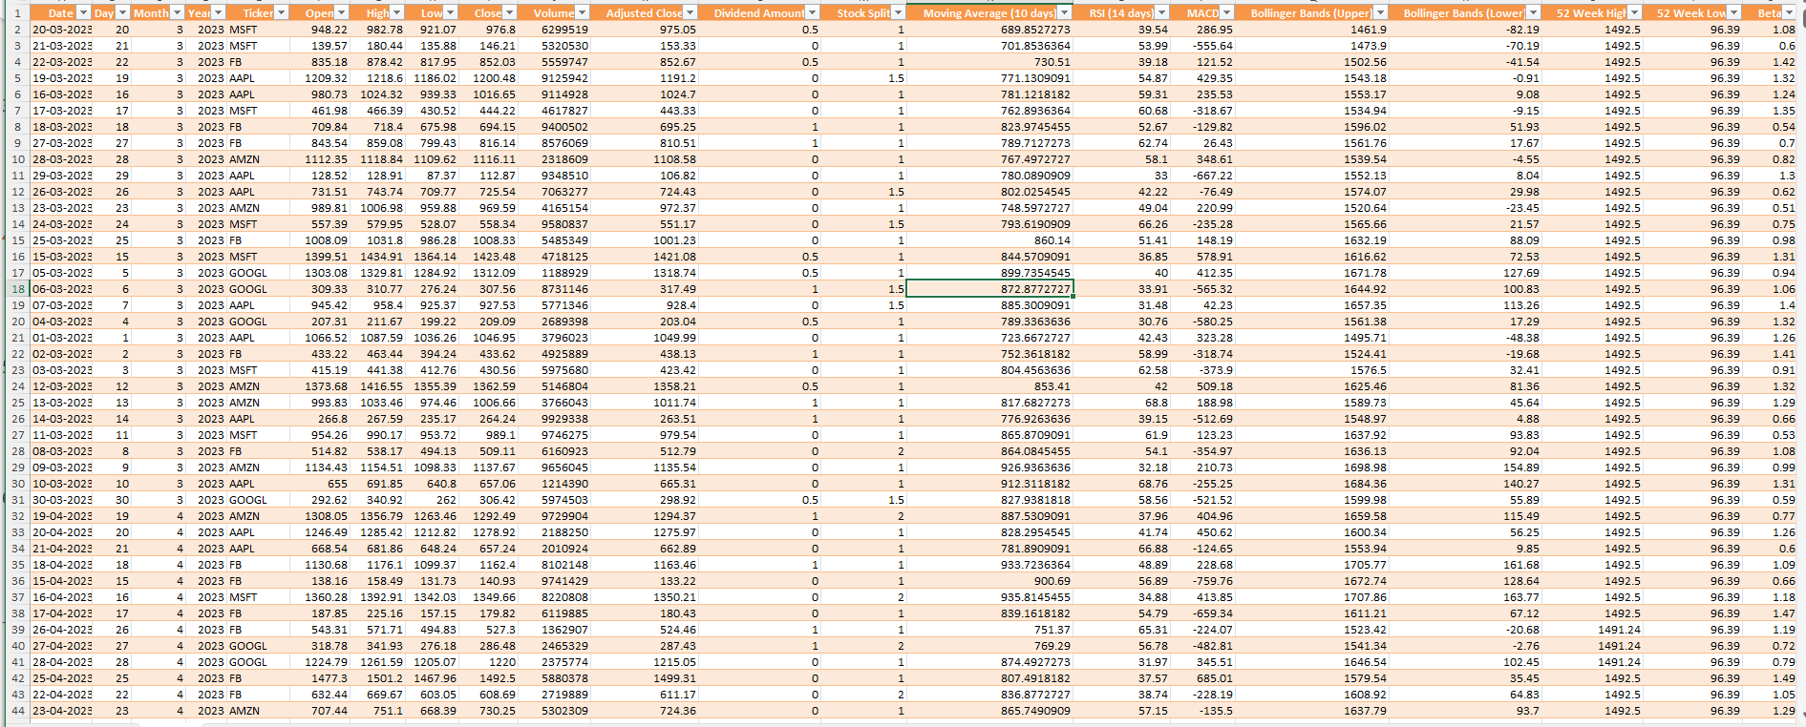
Project analysis slide 3
Stock Performance Analysis
DATA TRANSFORMATION

Slide 5
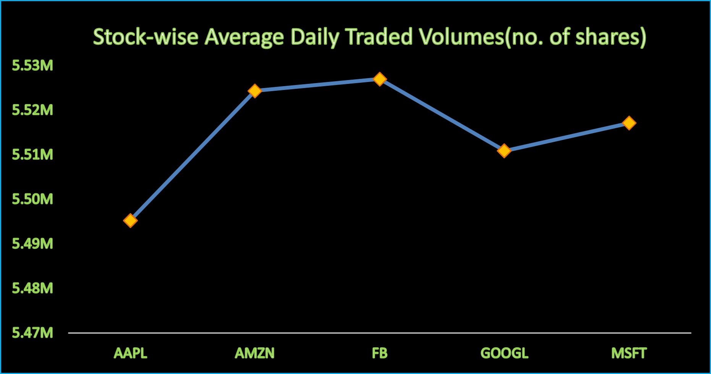
Project analysis slide 3
Stock Performance Analysis
KPI :1 – Average Daily Trading Volume
Observations:
FB has highest Average Trading Volume .
AAPL has lowest Average Trading Volume.
Conclusion:
It indicates the level of liquidity in the market. In this specific dataset:
1.FB-it indicates that buying and selling shares can be done with ease without significantly affecting the stock's price. it is highly liquid.
2.AAPL-It mean that buying or selling shares of AMZN might have a more significant impact on its stock price. It has lower liquidity .

Slide 6
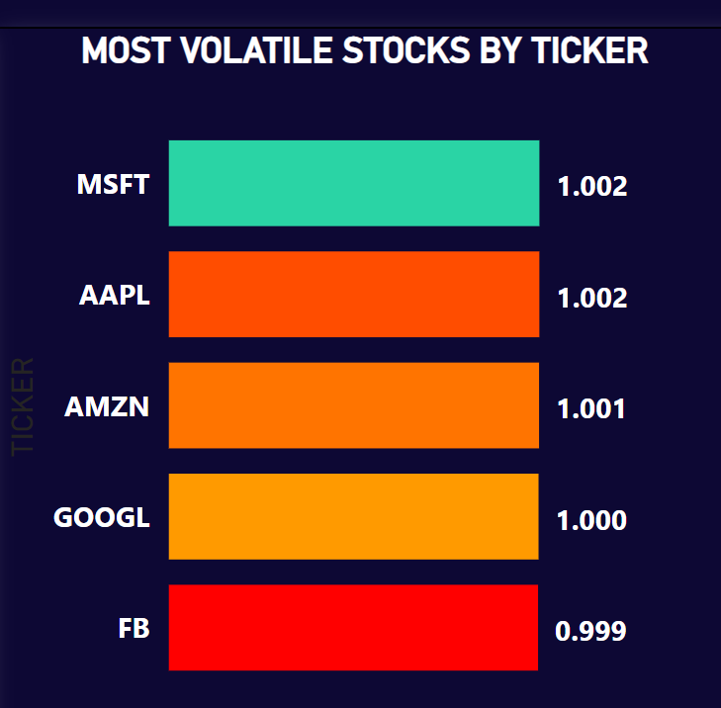
Project analysis slide 3
Stock Performance Analysis
KPI 2: – Most Volatile Stocks
Observations:
MSFT has highest beta value
FB has lowest beta value
Conclusion:
Beta is a measure of a stock's price sensitivity to market movements.
MSFT-
-It is more volatile and has higher price sensitivity to market movement.
-Investors should be aware that higher volatility can lead to larger price fluctuations, both upward and downward.
2. FB
-It is less volatile and has lower price sensitivity to market movements.
-the stock's price is expected to be less affected by general market fluctuations. While this can offer a more stable investment, it may also mean potentially lower returns during strong market upswings.

Slide 7
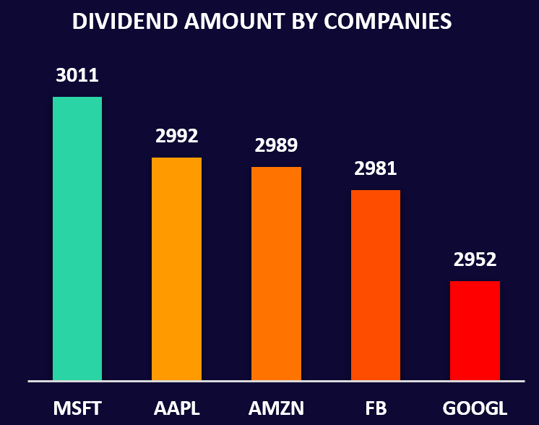
Project analysis slide 3
Stock Performance Analysis
KPI :3 – Stock-Wise Dividend Amount
Observations:
MSFT has given more dividend amount
Google has given least dividend amount
Conclusion:
Microsoft is sharing more of its profits with its investors compared to Apple, Amazon, Facebook, and Google.

Slide 8
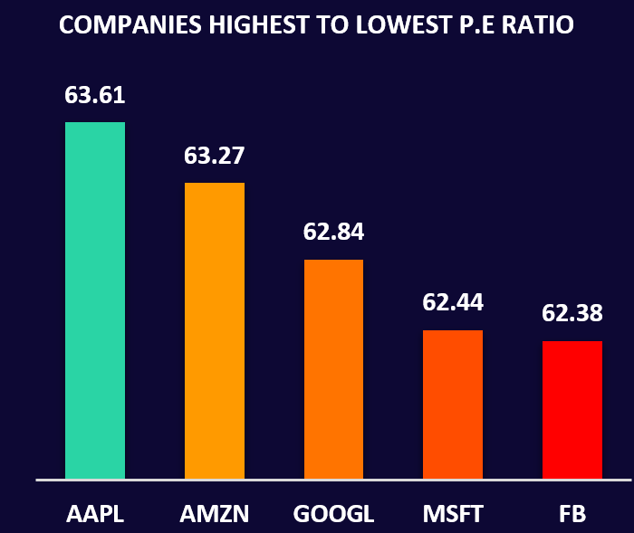
Project analysis slide 4
Stock Performance Analysis
KPI :4 – Stock-Wise P/E Ratio
Observations:
APL has highest p/e ratio.
FB has lowest p/e ratio.
Conclusion:
All the companies have relatively high average P/E ratios, indicating that investors are willing to pay a premium for their stocks and these companies have a lot of potential for growth and earnings, making them attractive to investors.

Slide 9
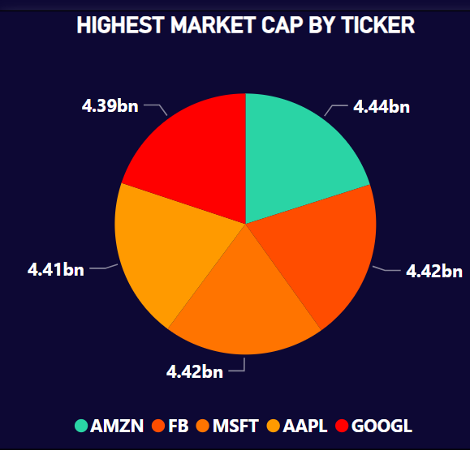
Project analysis slide 5
Stock Performance Analysis
KPI :5 – Stock-Wise Market Cap
Observations:
Amazon, Facebook, Microsoft, Apple, and Google are all seen as very close in value.
Amazon having the highest and
Google having the lowest market cap.
Conclusion:
Among these companies, Amazon has the highest perceived value at $4.44 billion.
It's currently holding the top spot in terms of market capitalization in this graph.
This reflects positive investor confidence in the overall strength of the tech industry amidst favorable market conditions.

Slide 10
Project analysis slide 5
Stock Performance Analysis
KPI 6:- Stock-wise 52 week high and 52 week low
Observations:
All the companies having almost same 52 week high and 52 week low stock prices.
Conclusion:
All companies are MNC’s and top performing companies in the world.

Slide 11
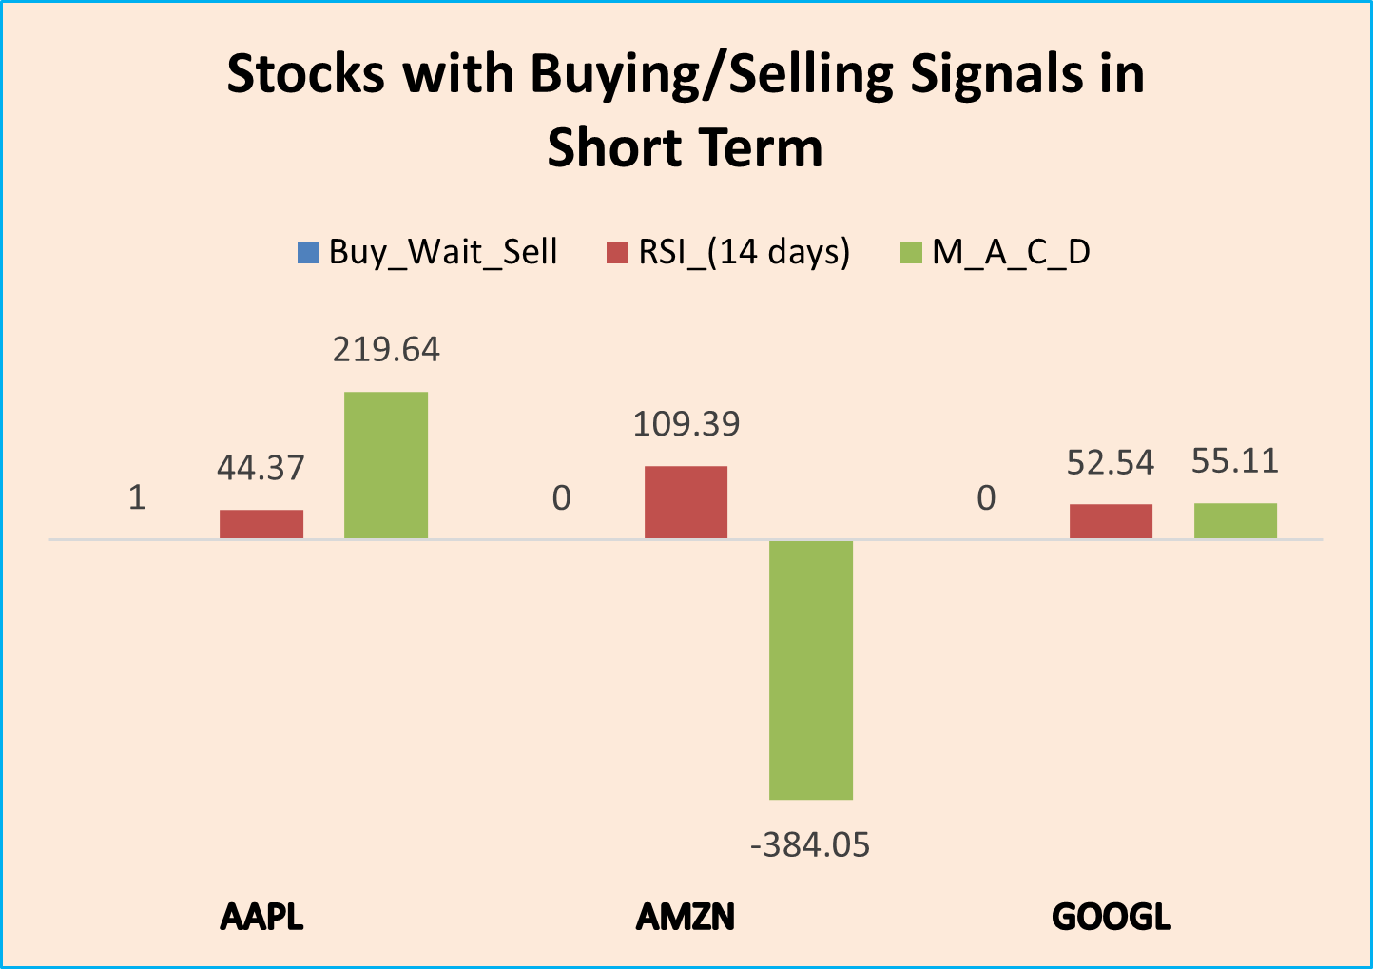
Project analysis slide 5
Stock Performance Analysis
KPI 7:- Buy/Wait/Sell Signal for stocks
Observations:
614(1.2%) days sell signal
9,400(18.8%) days buy signal
39,986(79.9%) days wait signal
Conclusion:
Hardly no negative performance by any company.
1->buy
-1->sell
0->wait

Slide 12
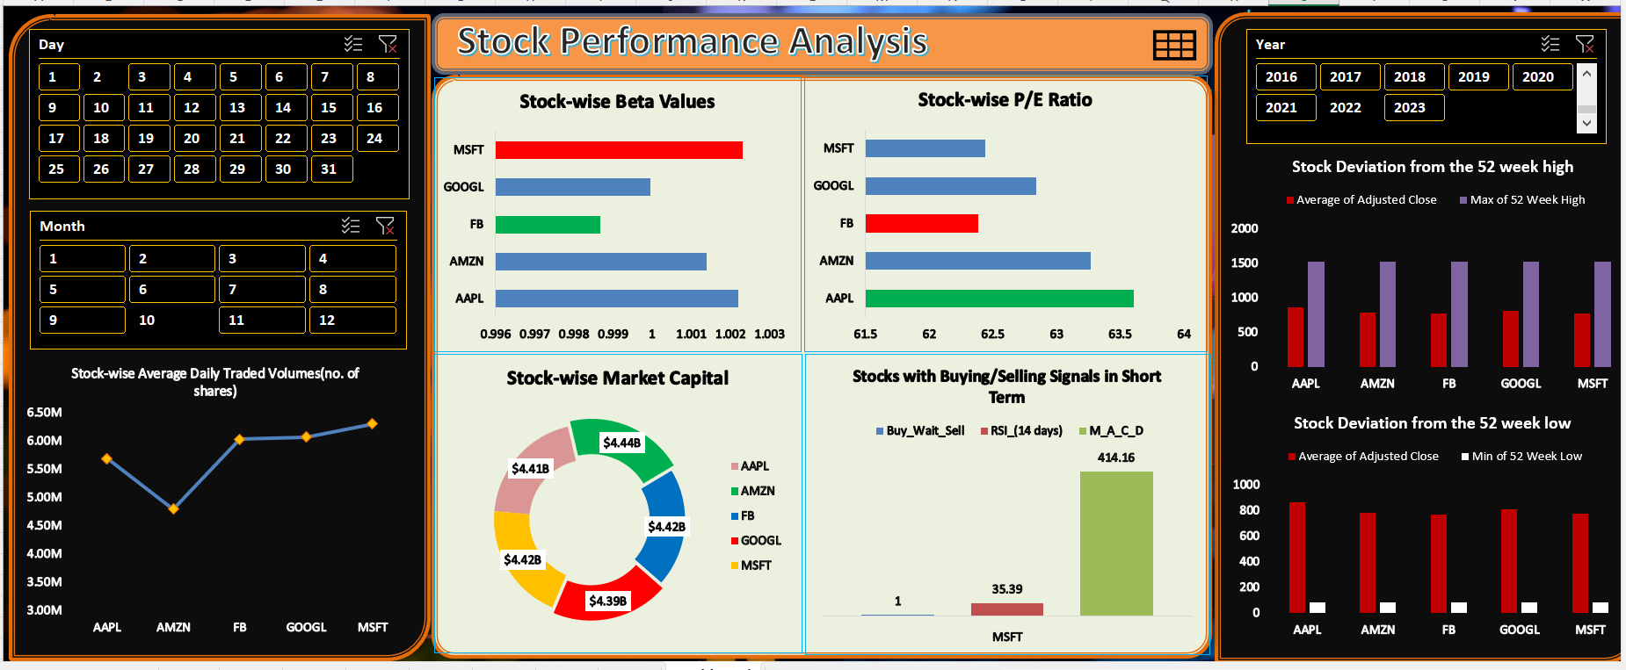
Project analysis slide 6
Stock Performance Analysis
EXCEL Dashboard

Slide 13
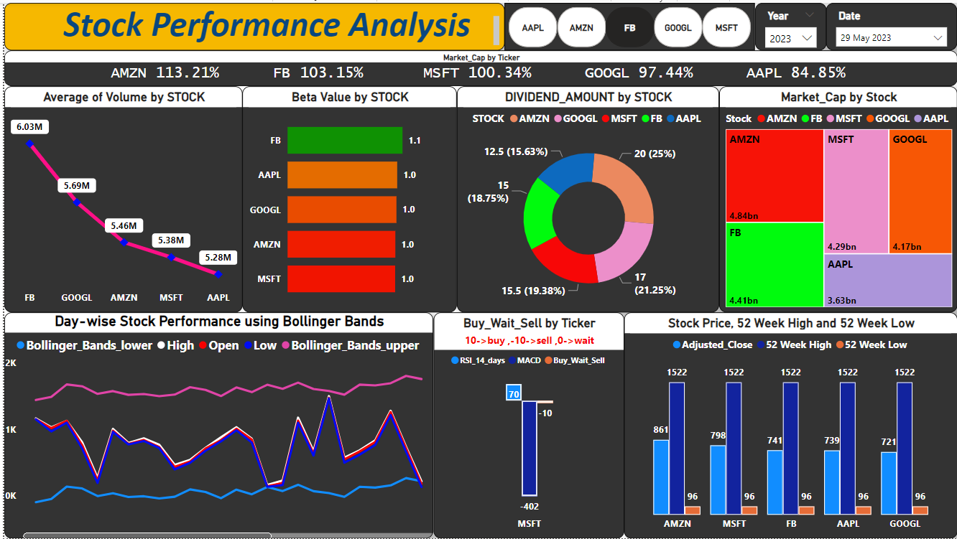
Project analysis slide 7
Stock Performance Analysis
POWER BI
Dashboard

Slide 14
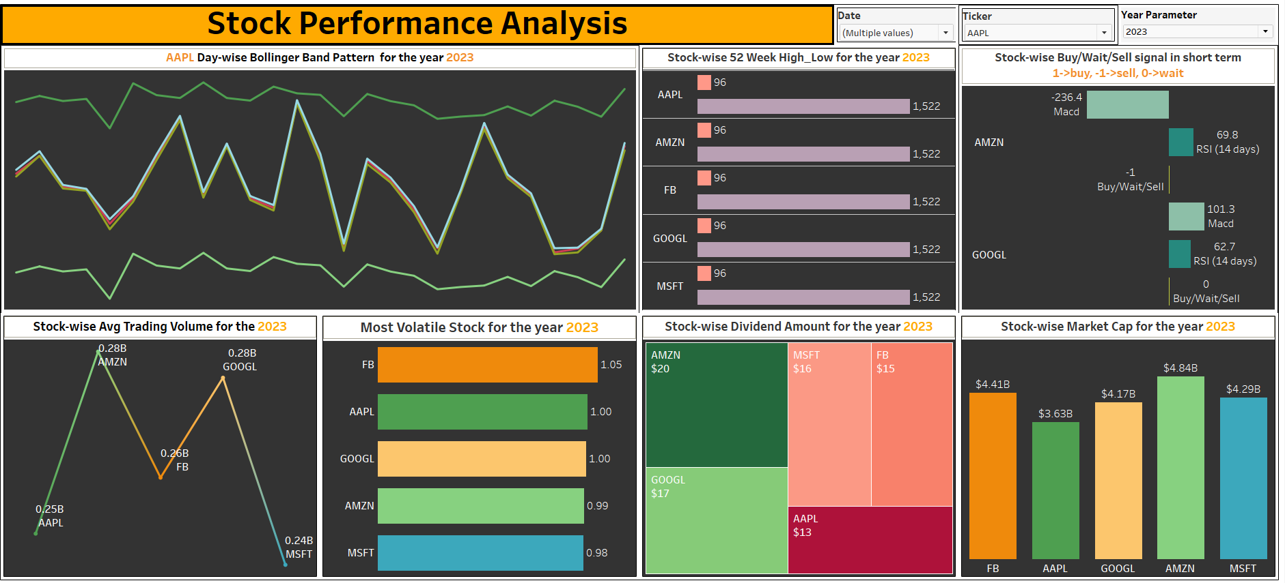
Project analysis slide 8
Stock Performance Analysis
TABLEAU Dashboard

Slide 15
Project analysis slide 10
Stock Performance Analysis
Dealing with date column in excel.
Understanding attributes of the data(domain knowledge).
CHALLENGES

Slide 16
Project analysis slide 5
Stock Performance Analysis
Insights
01
02
03
04
05
06
07
Market Popularity and Liquidity.
Volatility and Price Movements.
Dividend History.
Company Performance.
Amazon’s Dominance.
Google’s Relative Position..
Emphasis on Bullish Bias.
Frequent Buy Signals.
Diversification.
Risk and Returns.
Investor Sentiment.
Earnings Stability.
Potential for Opportunities.
Sector-wide Trends.

Slide 17
Thank You

